Slide 1
Operations on Binary Trees

Slide 2
Representation of Binary Tree
Struct node { int data; struct node * left, right; };

Slide 3
Binary Tree Traversal
1. Preorder traversal:-In this traversal method first process root element, then left sub tree and then right sub tree.
Procedure:-
Step 1: Visit root node
Step 2: Visit left sub tree in preorder
Step 3: Visit right sub tree in preorder

Slide 4
2. Inorder traversal:-
In this traversal method first process left element, then root element and then the right element.
Procedure:-
Step 1: Visit left sub tree in inorder
Step 2: Visit root node
Step 3: Visit right sub tree in inorder

Slide 5
3. Postorder traversal:-
In this traversal first visit / process left sub tree, then right sub tree and then the root element.
Procedure:-
Step 1: Visit left sub tree in postorder
Step 2: Visit right sub tree in postorder
Step 3: Visit root node

Slide 6
Arithmetic Expression Using BT
+
inorder traversal
A / B * C * D + E
infix expression
preorder traversal
+ * * / A B C D E
prefix expression
postorder traversal
A B / C * D * E +
postfix expression
level order traversal
+ * E * D / C A B
*
E
*
D
/
C
A
B

Slide 7
Inorder Traversal (recursive version)
void inorder(tree_pointer ptr)
/* inorder tree traversal */
{
if (ptr) {
inorder(ptr->left_child);
printf(“%d”, ptr->data);
indorder(ptr->right_child);
}
}
A / B * C * D + E

Slide 8
Preorder Traversal (recursive version)
void preorder(tree_pointer ptr)
/* preorder tree traversal */
{
if (ptr) {
printf(“%d”, ptr->data);
preorder(ptr->left_child);
predorder(ptr->right_child);
}
}
+ * * / A B C D E

Slide 9
Postorder Traversal (recursive version)
void postorder(tree_pointer ptr)
/* postorder tree traversal */
{
if (ptr) {
postorder(ptr->left_child);
postdorder(ptr->right_child);
printf(“%d”, ptr->data);
}
}
A B / C * D * E +

Slide 10
Iterative Inorder Traversal (using stack)
void iter_inorder(tree_pointer node)
{
int top= -1; /* initialize stack */
tree_pointer stack[MAX_STACK_SIZE];
for (;;) {
for (; node; node=node->left_child)
add(&top, node);/* add to stack */
node= delete(&top);
/* delete from stack */
if (!node) break; /* empty stack */
printf(“%D”, node->data);
node = node->right_child;
}
}
O(n)

Slide 11
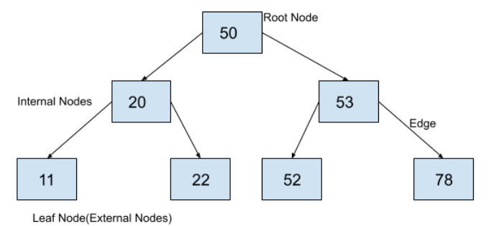
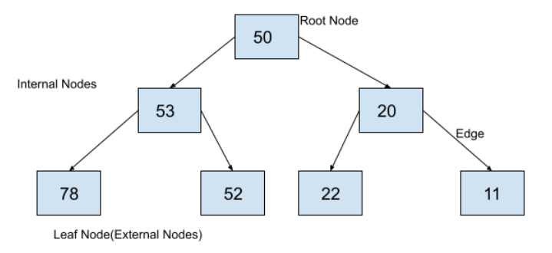
Mirror Image
Mirror image of a binary tree is another binary tree which can be created by swapping left child and right child at each node of a tree. So, to find the mirror image of a binary tree, we just have to swap the left child and right child of each node in the binary tree.

Slide 12
Mirror Image
Create the binary tree with dummy data.
Write a recursive function to find the mirror of the given binary tree.
Recursively call the function with left and right nodes.
Swap the left node data with the right node data.
Print the tree.

Slide 13
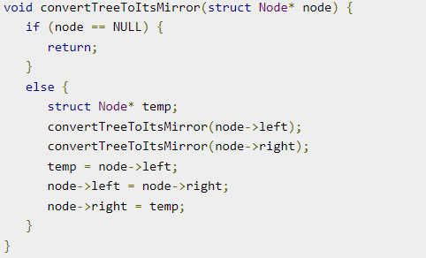
Mirror Image

Slide 14
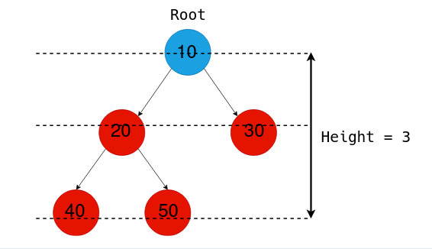
Height
The height of a Binary Tree is defined as the maximum depth of any leaf node from the root node. That is, it is the length of the longest path from the root node to any leaf node.

Slide 15
Finding Height of Binary Tree
// Find height of a tree, defined by the root node
int tree_height (Node* root) {
if (root == NULL)
return 0;
else {
// Find the height of left, right subtrees
left_height = tree_height(root->left);
right_height = tree_height(root->right);
// Find max(subtree_height) + 1 to get the height of the tree
return max(left_height, right_height) + 1;
}

Slide 16
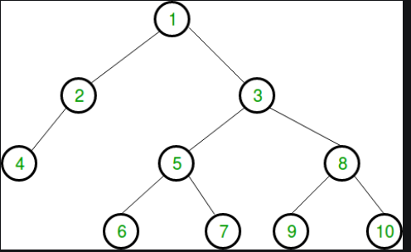
Finding Leaf Nodes
Given a binary tree, we need to write a program to print all leaf nodes of the given binary tree from left to right. That is, the nodes should be printed in the order they appear from left to right in the given tree.
Leaf Nodes: 4,6,7,9,10

Slide 17
Algorithm to Print Leaf Nodes
Check if the given node is null. If null, then return from the function.
Check if it is a leaf node. If the node is a leaf node, then print its data.
If in the above step, the node is not a leaf node then check if the left and right children of node exist. If yes then call the function for left and right child of the node recursively.

Slide 18
Algorithm to Print Leaf Nodes
void printLeafNodes(Node *root)
{
// if node is null, return
if (!root)
return;
// if node is leaf node, print its data
if (!root->left && !root->right)
{
cout << root->data << " ";
return;
}
// if left child exists, check for leaf
// recursively
if (root->left)
printLeafNodes(root->left);
// if right child exists, check for leaf
// recursively
if (root->right)
printLeafNodes(root->right);
}

Slide 19
Counting the number of nodes
static int count = 0;
int countnodes(struct node *root)
{
if(root != NULL)
{
countnodes(root->left);
count++;
countnodes(root->right);
}
return count;
}

Slide 20
Level wise Traversal
First find the height of the tree
Print the nodes corresponding to every level.
Iterate all levels until the height, and print nodes at every level.
void print_tree_level_order(Node* root) {
int height = tree_height(root);
for (int i=0; i<height; i++) {
// Print the ith level
print_level(root, i);
}
}

Slide 21
Level wise Traversal
void print_level(Node* root, int level_no) {
// Prints the nodes in the tree
// having a level = level_no
// We have a auxiliary root node
// for printing the root of every sub-tree
if (!root)
return;
if (level_no == 0) {
// We are at the top of a sub-tree
// So print the auxiliary root node
printf("%d -> ", root->value);
}
}
else {
// Make the auxiliary root node to
// be the left and right nodes for
// the sub-trees and decrease level by 1,
print_level(root->left, level_no - 1);
print_level(root->right, level_no - 1);
}
}

